Slide 1
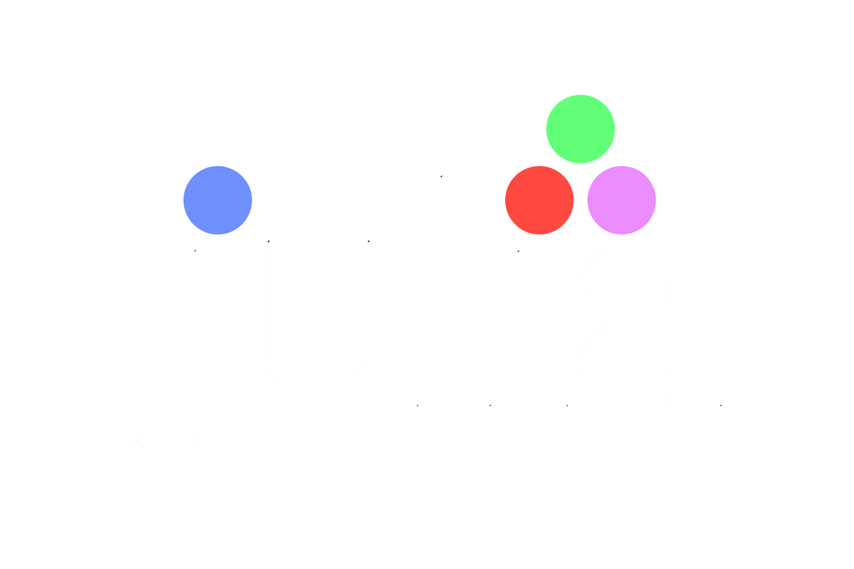
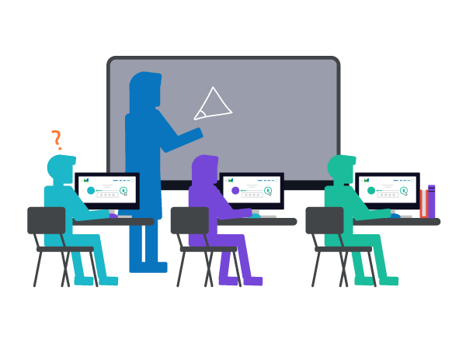
For Beginners!
© Copyright Matthew Flood, 2022

Slide 2

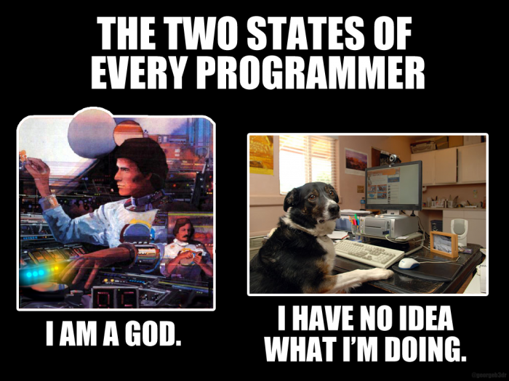

Aim of this course
Now
6 Weeks From Now
6 – 18 Months From Now

Slide 3






Course Overview
Week 1 (Today)
What’s so great about Julia?
What is the Julia REPL?
How to install packages in Julia
Pluto – what we’ll be using throughout the course

Slide 4



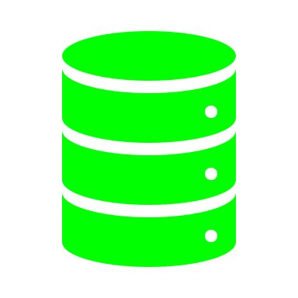


Course Overview
Week 2
Julia files and modules
Data types (IMPORTANT)
Collections and data structures
Overview of Objects
How to make beautiful plots in Julia

Slide 5

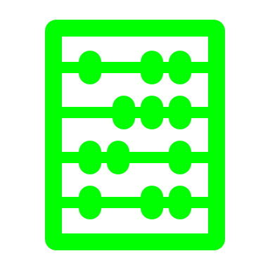


Course Overview
Week 3
For and While loops, and the BANG operator
Conditional statements (if-else)
Try-Catch statements
Interactive user input

Slide 6



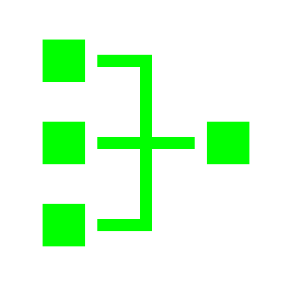
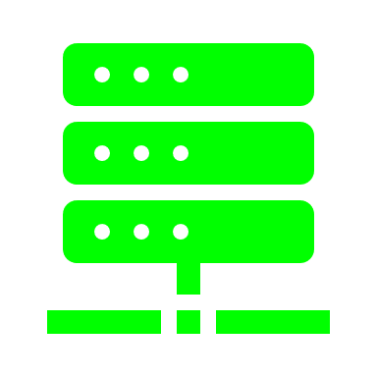
Course Overview
Week 4
What are Functions? (spoiler: the most important thing in programming)
Function arguments
Composite types (structs)
Struct methods

Slide 7



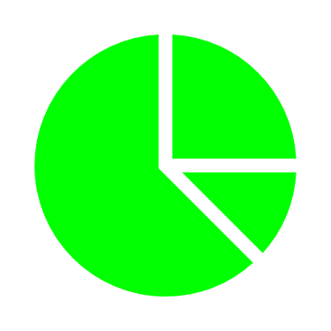

Course Overview
Week 5
Similarity between MatLab and Numpy
Important maths packages
Statistics in Julia (for the nerds)
Vector + Matrix operations

Slide 8



Course Overview
Week 6
Similarity between Pandas and R
DataFrames 101
Data visualization in Julia
Quick exam to see if you were paying attention

Slide 9
For Beginners!
Week 1:
Why Learn Julia?
The Julia REPL
Installing Packages in Julia
Pluto

Slide 10

Programming is…
…especially in research
Notes:
Jobs prospects // Replication of scientific findings // Speed up your tasks and jobs // fun!

Slide 11
What is a programming language?
A series of structured commands – computer code – that tells a computer what to do.
Like a spoken language, there are many programming languages that have different syntax and expressions.
Each language converts commands into machine code (binary computer code) using a compiler.
Computers are not smart or intelligent.
They must be told exactly what to do and how to do it.
Thus, correct programming grammar and spelling are CRUCIAL.
A series of commands that performs a task is called an algorithm.

Slide 12









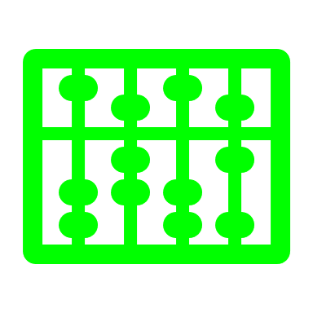




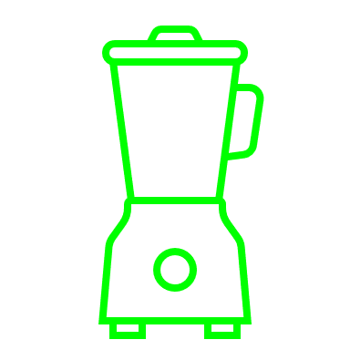










Programming
Cooking
Programmer
Chef
Language (Python, Java, etc.)
Cuisine (Italian, Mexican, etc.)
Algorithms
Recipes
Functions and methods
Ingredients
Packages
Utensils
Compilation time
Cooking time
Self-written code
Home-cooked meal
Borrowed code
Restaurant meal
(Michelin star or McDonald’s)
This class
Cookery class / Dinner party

Slide 13




What’s different about Julia?

Slide 14
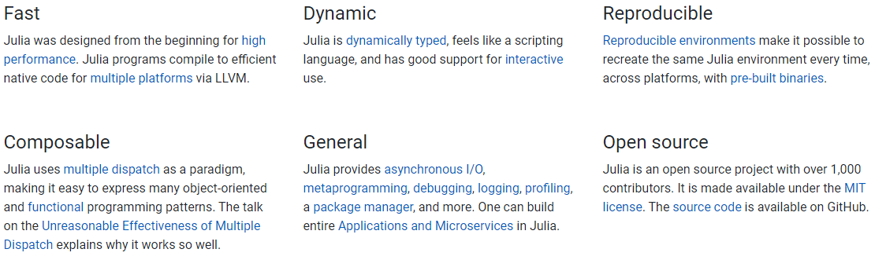
What’s different about Julia
Compared to other high-level languages?
julialang.org
Notes:
Explain high-level language

Slide 15
What’s different about Julia
Compared to other high-level languages?
Traditionally, mathematical programming languages could be dichotomously classified as productive or performant. Productive languages are easier (faster) to write and manipulate, but run slowly. By contrast, performant languages were fast, but laborious and tedious to write.
It seemed that languages could either be performant or productive, but not both…
… until Julia came along.
Julia is designed to be performant, productive and general, i.e. it is easy to write, fast to run, and can be used to do a wide array of jobs from machine learning and statistics, to web/game development and data visualization.
Notes:
Explain high-level language

Slide 16
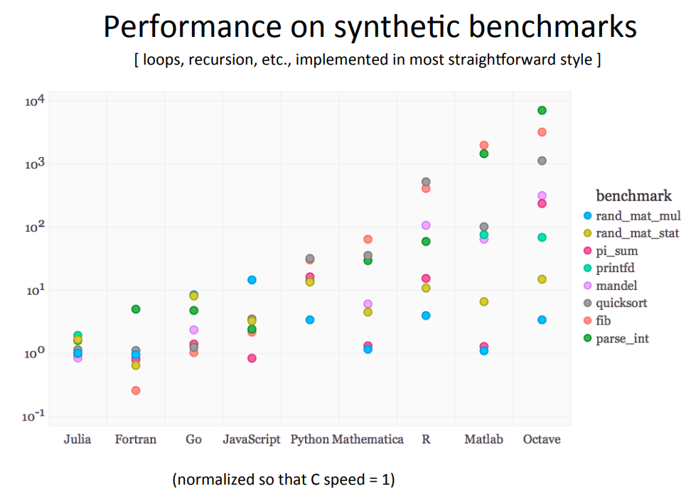
What’s different about Julia?
Notes:
Explain high-level language

Slide 17


Julia Pro’s and Cons
Fast
Friendly and active user community
Advanced packages (especially for mathematics)
Combines best of MatLab and Python
Open-source
Cool formatting extras
Centralised documentation
Unclear error messages
Still young > some packages not yet available > limited online solutions
Not fully documented

Slide 18
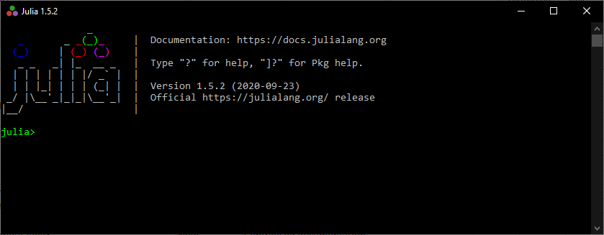
Julia REPL
Read
Eval
Print
Loop
The REPL is the interface where your code is executed.
The Julia REPL has 3 important modes:
The Julian mode
The Help mode
The Package (Pkg) mode
Notes:
The repl read your code and then evaluates it.
If it runs properly, it prints out the result.
Otherwise it will print an error.
Then it loops back and is ready for the next command.
Do demo with hello world

Slide 19
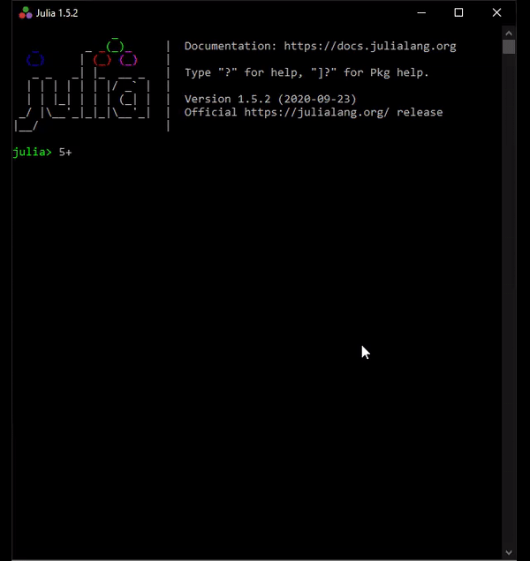
Julian REPL
Read
Eval
Print
Loop
Notes:
The repl read your code and then evaluates it.
If it runs properly, it prints out the result.
Otherwise it will print an error.
Then it loops back and is ready for the next command.
Do demo with hello world

Slide 20

Help REPL
Type ?
Type word
Hit enter

Slide 21





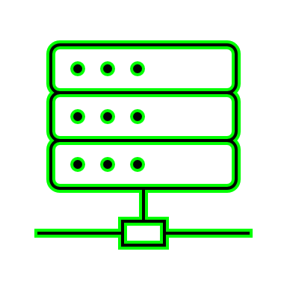




What are Packages?
Packages are like toolboxes: A collection of functions and other tools that perform specific jobs
Packages have a theme, such as statistics, machine learning, or plotting.
They are at the heart of Julia and everything you will programme. They speed up your projects.
Packages must be installed in order to use them.

Slide 22


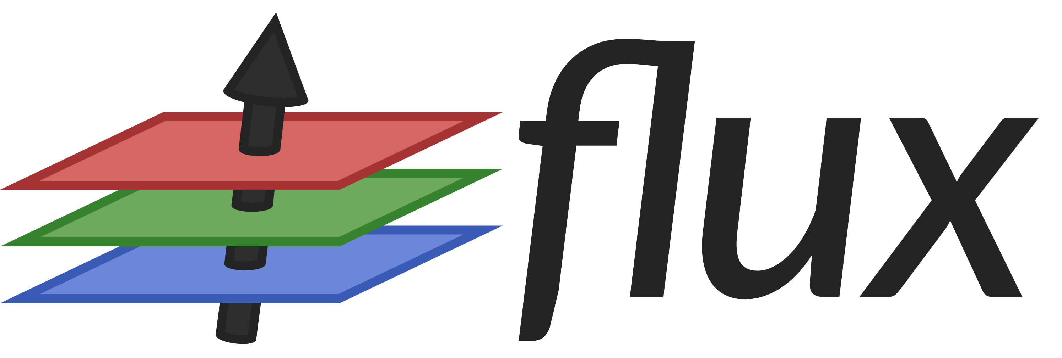


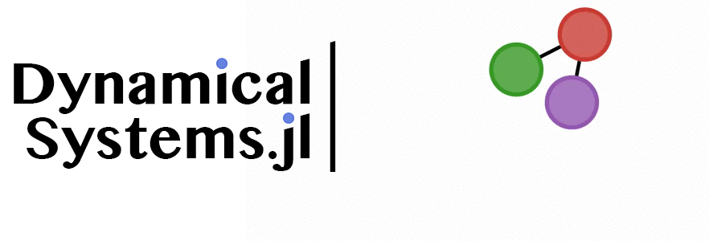



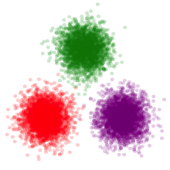
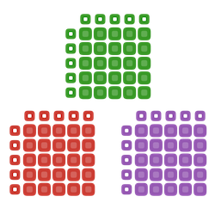

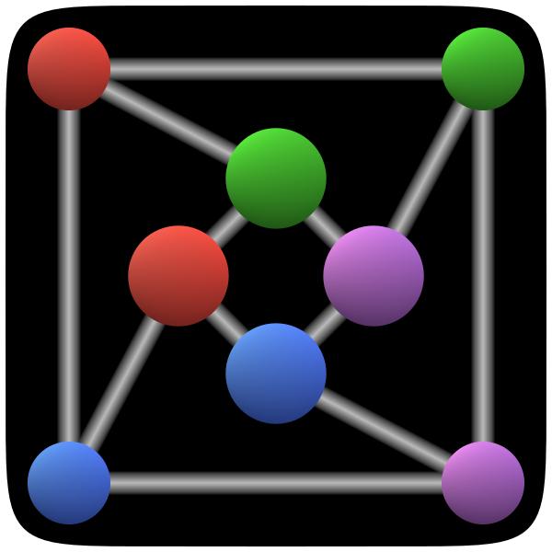
Cool Julia Packages
EntropyHub.jl*
DifferentialEquations.jl
StatsBase.jl
DataFrames.jl
Graphs.jl

Slide 23
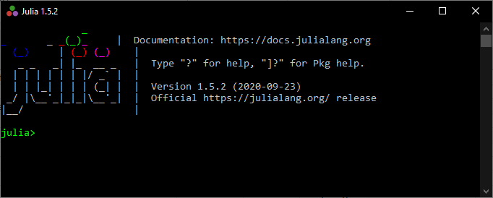
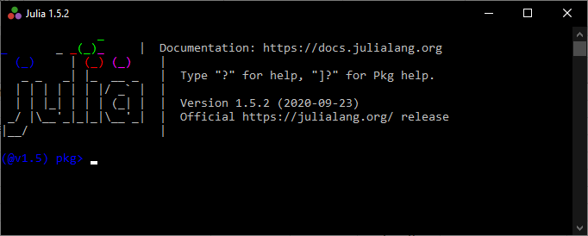
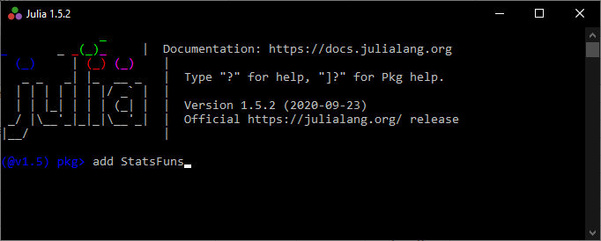
Installing Packages
Open the package REPL:
Type ]
Add the package: (@v1.7) pkg> add Example

Slide 24
Package REPL
To install a package (case sensitive):
(@v1.6) pkg> add PackageName
To uninstall (remove) a package:
(@v1.6) pkg> rm PackageName
To see a list of installed packages:
(@v1.6) pkg> status

Slide 25
Using Packages
Once a package has been installed, you must import it in order to use it.
To do this, we type:
julia> using PackageName
This is like “import” in Python
It is common practice to import all your packages at the start of your programme in the first few lines.

Slide 26
Where to write code?
When we develop programmes, we want to be able to check that they run correctly and we can fix any errors that come up.
To do this, we write code into files that can be saved and execute code directly from these files.
In order to execute code and see the output, programmers use what is called an IDE – integrated development environment.
An IDE is basically a text editor that helps you write code efficiently and correctly by giving suggestions (like auto-complete) and syntax highlighting (called linting), as well as toolbars for viewing the values of variables in your current workspace.
MatLab is an IDE, as are Spyder or PyCharm for Python.
Julia-friendly IDEs include Juno and Microsoft VScode.

Slide 27

Notebooks are an alternative to IDEs.
Notebooks are interactive interfaces that allow you to run code in blocks, or “cells”, and see the outputs in stages.
Notebooks are often run through browsers (like chrome/firefox) and execute code behind the scenes using “kernels”.
Jupyter notebooks are popular for Pythonistas, which can also be used for Julia.
In this course, we will use Pluto, a notebook designed specifically for Julians.

Slide 28
Further Reading:
Julia Home >>> julialang.org/
Julia Wiki >>> en.wikipedia.org/wiki/Julia_(programming_language)
Julia User Forum >>> discourse.julialang.org/
Julia Package List >>> juliahub.com/ui/Home
Documentation >>> docs.julialang.org/en/v1/
Pluto >>> github.com/fonsp/Pluto.jl Pluto >>> www.youtube.com/watch?v=IAF8DjrQSSk
YouTube Channel >>> www.youtube.com/user/JuliaLanguage
Helpful Videos >>> https://youtu.be/8h8rQyEpiZA
Helpful Videos >>> https://youtu.be/SLE0vz85Rqo
For Beginners!

Slide 29

Like learning a real language, the only way to become fluent is to practice.
With that said,
let’s start writing some code!!!

Slide 30
Week 1 Tutorial:
Using the help REPL
Using the package REPL
Install Pluto and Ijulia
Open Pluto
For Beginners!

